Slide 1


CGB1221 DATABASE MANAGEMENT SYSTEMS PROJECT REVIEW
Department of Computer Science and Engineering
Academic Year: 2024 – 2025 (Even Semester)
Register Number:2303811710421092
Name :MATHAN M
Year :II
Semester :IV
Section :B
Date :03/06/2025
Guided : Mr.P.MATHESWARAN M.E.,Ph.D.,

Slide 2
Title of the Project
INSURANCE MANAGEMENT SYSTEM

Slide 3
Abstract
This project is a website for managing insurance services online.
Customers can register, view and buy insurance policies.
They can also pay premiums and submit claims easily.
Admins manage users, approve policies, and view reports.
The system is developed using HTML, CSS, PHP, and MySQL.

Slide 4
Introduction
Managing insurance manually is slow and prone to errors. This system makes the process faster and more organized. It offers a simple online platform where both users and admins can carry out their tasks from anywhere.

Slide 5
Database - Concepts Used
The database in the Insurance Management System stores and manages important data such as customer profiles, insurance policies, premium payments, and claim records. Each type of data is stored in a separate table—like users, policies, payments, and claims—with clear relationships between them. This setup supports smooth and efficient CRUD (Create, Read, Update, Delete) operations.
Normalization The database is normalized to avoid duplicate data and to keep the information consistent. Large tables are divided into smaller related tables to meet First Normal Form (1NF), Second Normal Form (2NF), and Third Normal Form (3NF). This helps improve system speed and makes the data easier to manage.

Slide 6
Database - Concepts Used
SQL Operations (DML Examples) The system uses SQL commands to handle the data:
INSERT INTO policies (policy_name, premium, duration) VALUES ('Health Plan', 5000, '1 Year’);
SELECT * FROM claims WHERE claim_status = 'Pending’;
DELETE FROM users WHERE user_id = 5;
Keys Used
Primary Key: A unique ID is assigned to each record. Example: users.user_id, policies.policy_id, claims.claim_id
Foreign Key: Used to connect tables to each other. Example: claims.user_id links to users.user_id to show which user filed the claim
Composite Key (if used): Can be created in tables like premium_payments using (user_id, policy_id) to track payments for a specific user-policy combination.

Slide 7
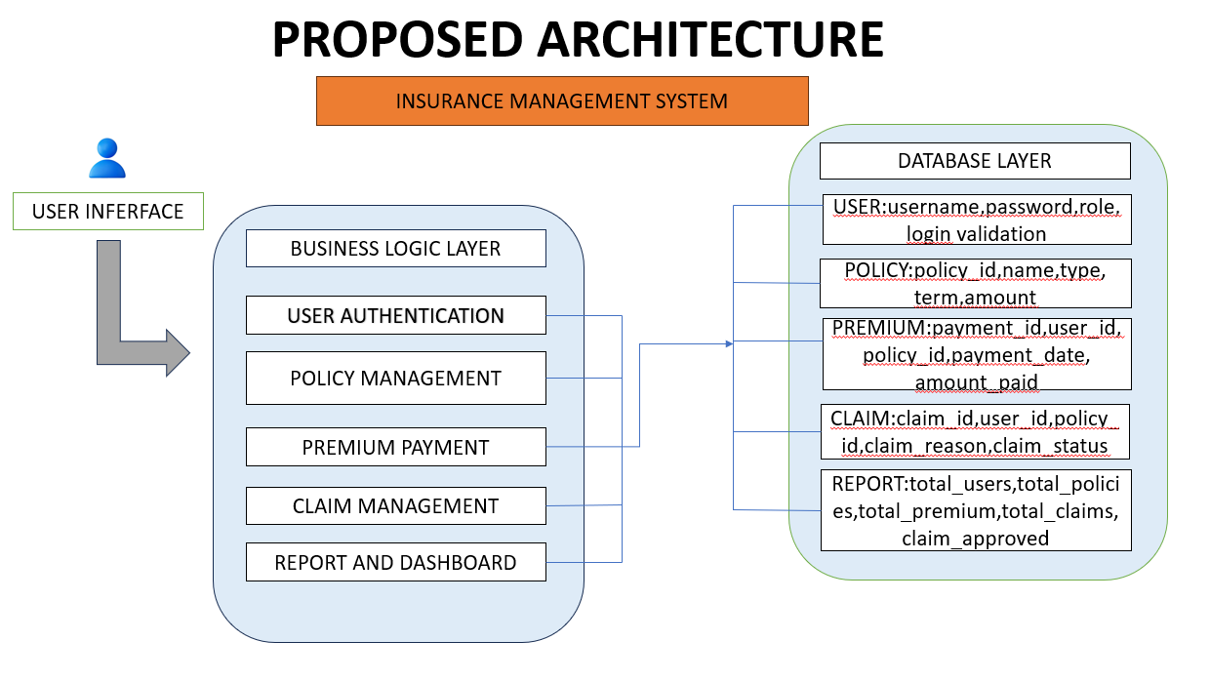
Proposed Architecture

Slide 8
Proposed Architecture - Description
Users access the system using a web browser
Customers can register, login, and view/buy insurance policies
Admins login to view policy applications, approve/reject them, and view claims
All actions are stored and tracked using a MySQL database

Slide 9
List of Modules
User Login & Registration
Admin Dashboard
Policy Management
Premium Payments
Claim Processing
Reports and Logs

Slide 10
Module Description
1.Login & Registration:
Customers and Admins login securely
2. Admin Dashboard:
Admins can manage categories, users, and policies
3. Policy Management:
Admins can add/edit/delete policies; customers can view and purchase

Slide 11
Module Description (Cont..)
4. Premium Payment:
Customers can make payments
5. Claim Management:
Customers submit claims; Admins approve/reject
6. Reports:
Admins can view policy and payment reports

Slide 12

Results and Discussion

Slide 13
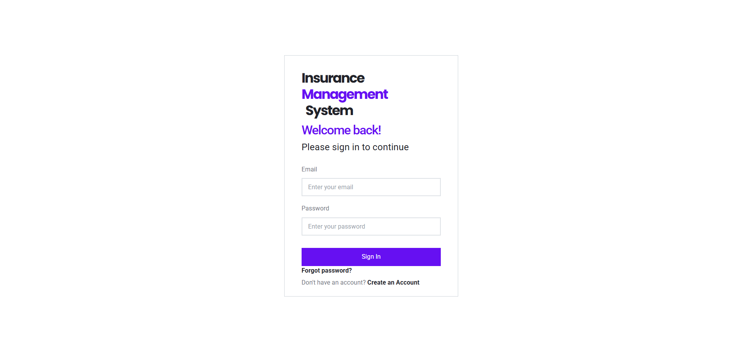
Results and Discussion (Cont..)

Slide 14
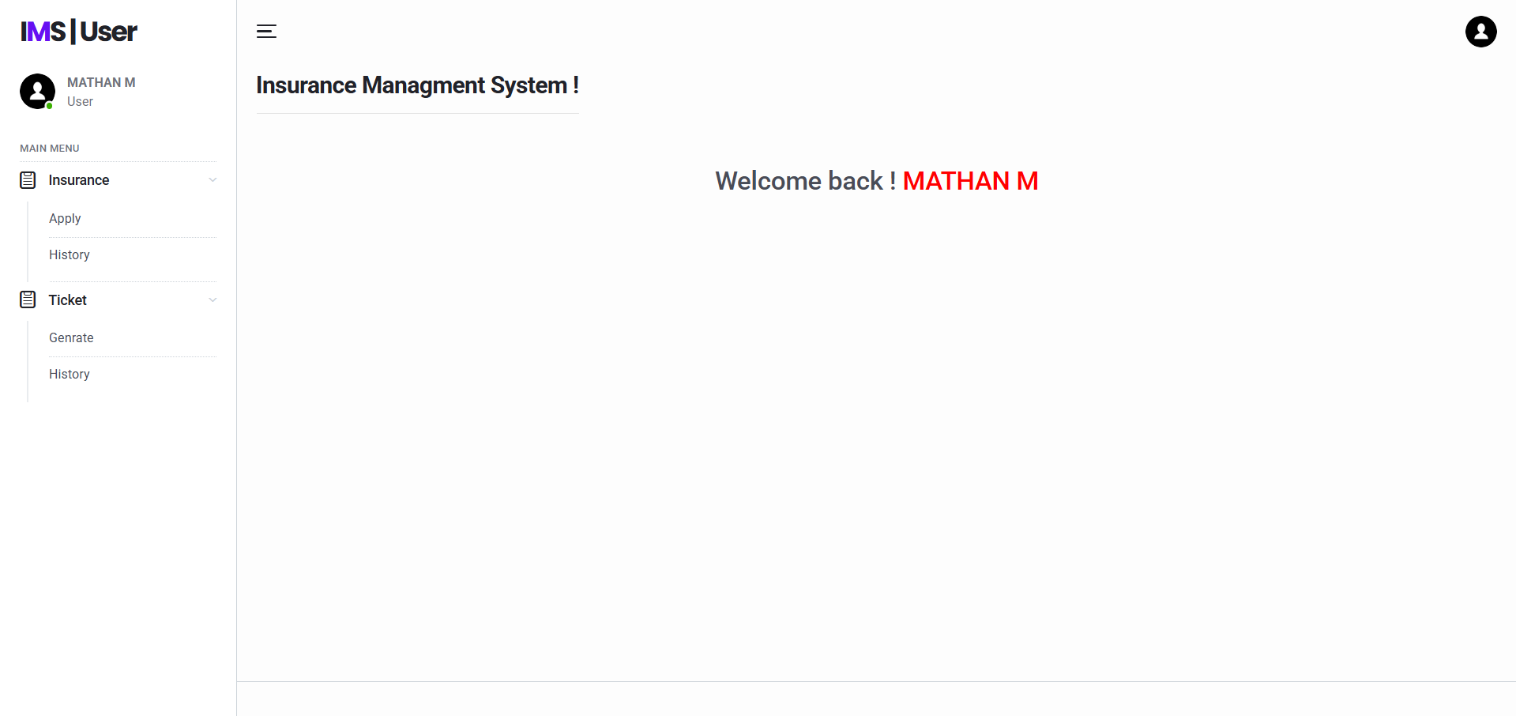
Results and Discussion (Cont..)

Slide 15
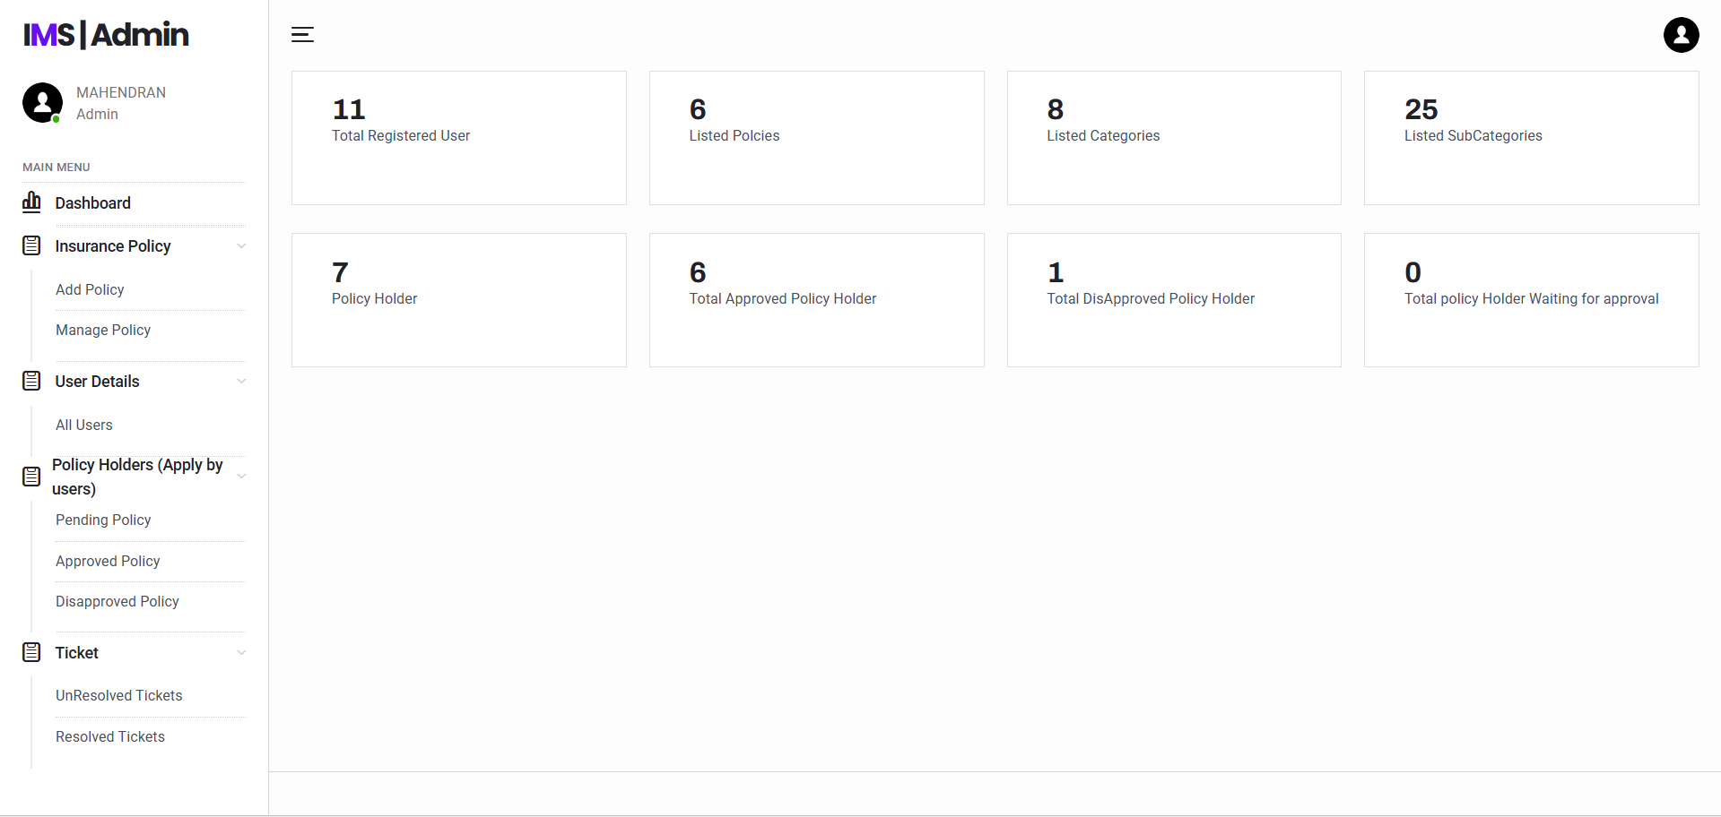
Results and Discussion (Cont..)

Slide 16
Conclusion
This Insurance Management System turns the manual insurance process into a digital one.It reduces the need for paperwork, makes approvals faster, and safely stores all data in a database.The system is simple to use and can be improved or expanded in the future if needed.

Slide 17
THANK YOU

